Slide 1

Week 4: The Research Process Reminder: You have two attempts to correct your homework.
This Photo by Unknown author is licensed under CC BY-SA.

Slide 2

Questions and Answers always on Thursdays.
This Thursday I will focus on questions and help with the homework. Please come if you got a low grade on the homework.

Slide 3
Homework: Making a quotation
To quote is to copy the exact wording. You cannot use quotation marks and page numbers for something from a different text or if you changed the words. Then it is not a quotation.
Therefore, it is incorrect, and marked wrong on the homework.
Use the class book, which is online, page 67, only.

Slide 4

Review of APA citation style:
You will do an entry for homework this week.

Slide 5
Review of APA citation style: Title of a book or journal in citations and in homework.
In italics, and not capitalized except for the first word of each part and names.
No quotation marks. No "Intercultural skills..."

Slide 6
APA References citation entry for an article
Lothery, E. (2022). Information technology governance mechanisms:
Achieving business-IT alignment in a local government.
Organization Development Review 54 (4), pp. 25 – 29.
See the article on the Home page as an example of what the original would look like.

Slide 7
Reference entry for an academic article
Byram, M., & Wagner, M. (2018). Making a difference: Language teaching for intercultural
and international dialogue. Foreign Language Annals, 51 (1).
Author's last name, initial. (year). Title of article. Title of Journal
in italics, 2 (3), pages. DOI or web address if necessary.
Title of article or book only capitalizes (caps) the first word and first word after a colon.
The title of the journal (magazine) is capitalized and in ITALICS.
And NEVER, NEVER, NEVER USE ALL CAPS.

Slide 8
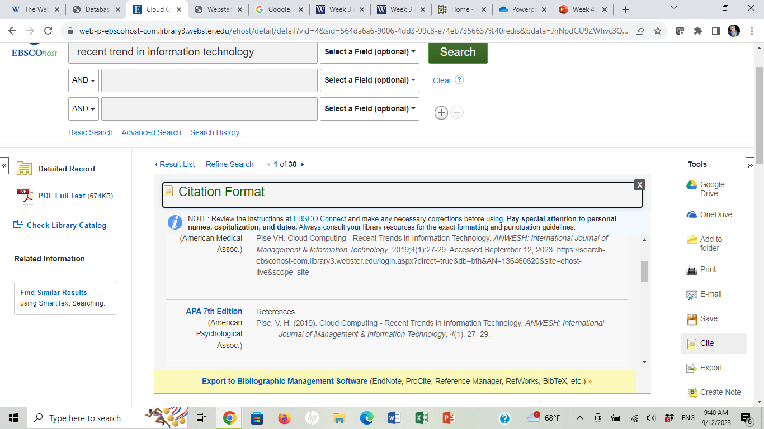
Careful with citation generators

Slide 9
"Quotation mark" use in APA
Not used for titles of books, journals or articles. MLA does for articles.
Used to indicate the exact words of a speaker or from an article. The author indicated that "less is more" (Smith, 2024, p. 10). = a quotation.
Used to indicate special meanings of words or phrases, especially if from another language.

Slide 10
Types of in-text citations using APA
At the end or middle of a sentence in parenthesis:
The values mentioned are best referred to as a cumulative
collaboration of evidence (LaScotte & Peters, 2021, p. 49).
In a signal phrase somewhere in a sentence:
According to LaScotte and Peters (2021), the first challenge is ...in class (p. 57).
The problem, according to Chavez (2022), is that people do not...
Usually author's last name and date. May include a page number.

Slide 11
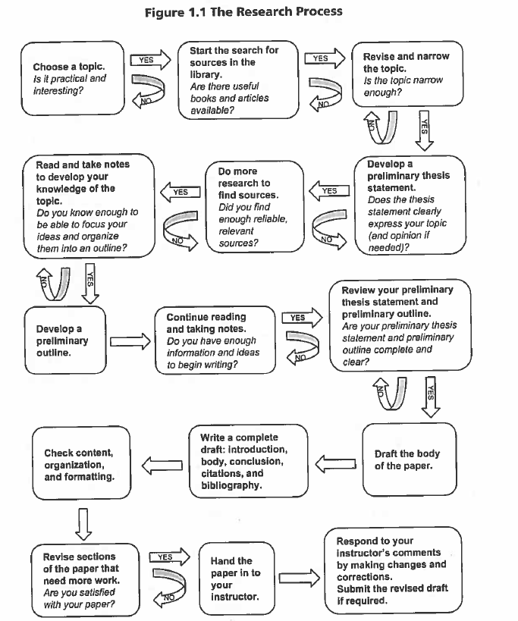
Topic Today: The Research Process
First steps?
When do you actually write the paper or a proposal?
Carlock, J., Maeve Eberhardt, Horst, J., & Kolenich, P. (2017). The international student’s guide to writing a research paper. University Of Michigan Press.

Slide 12
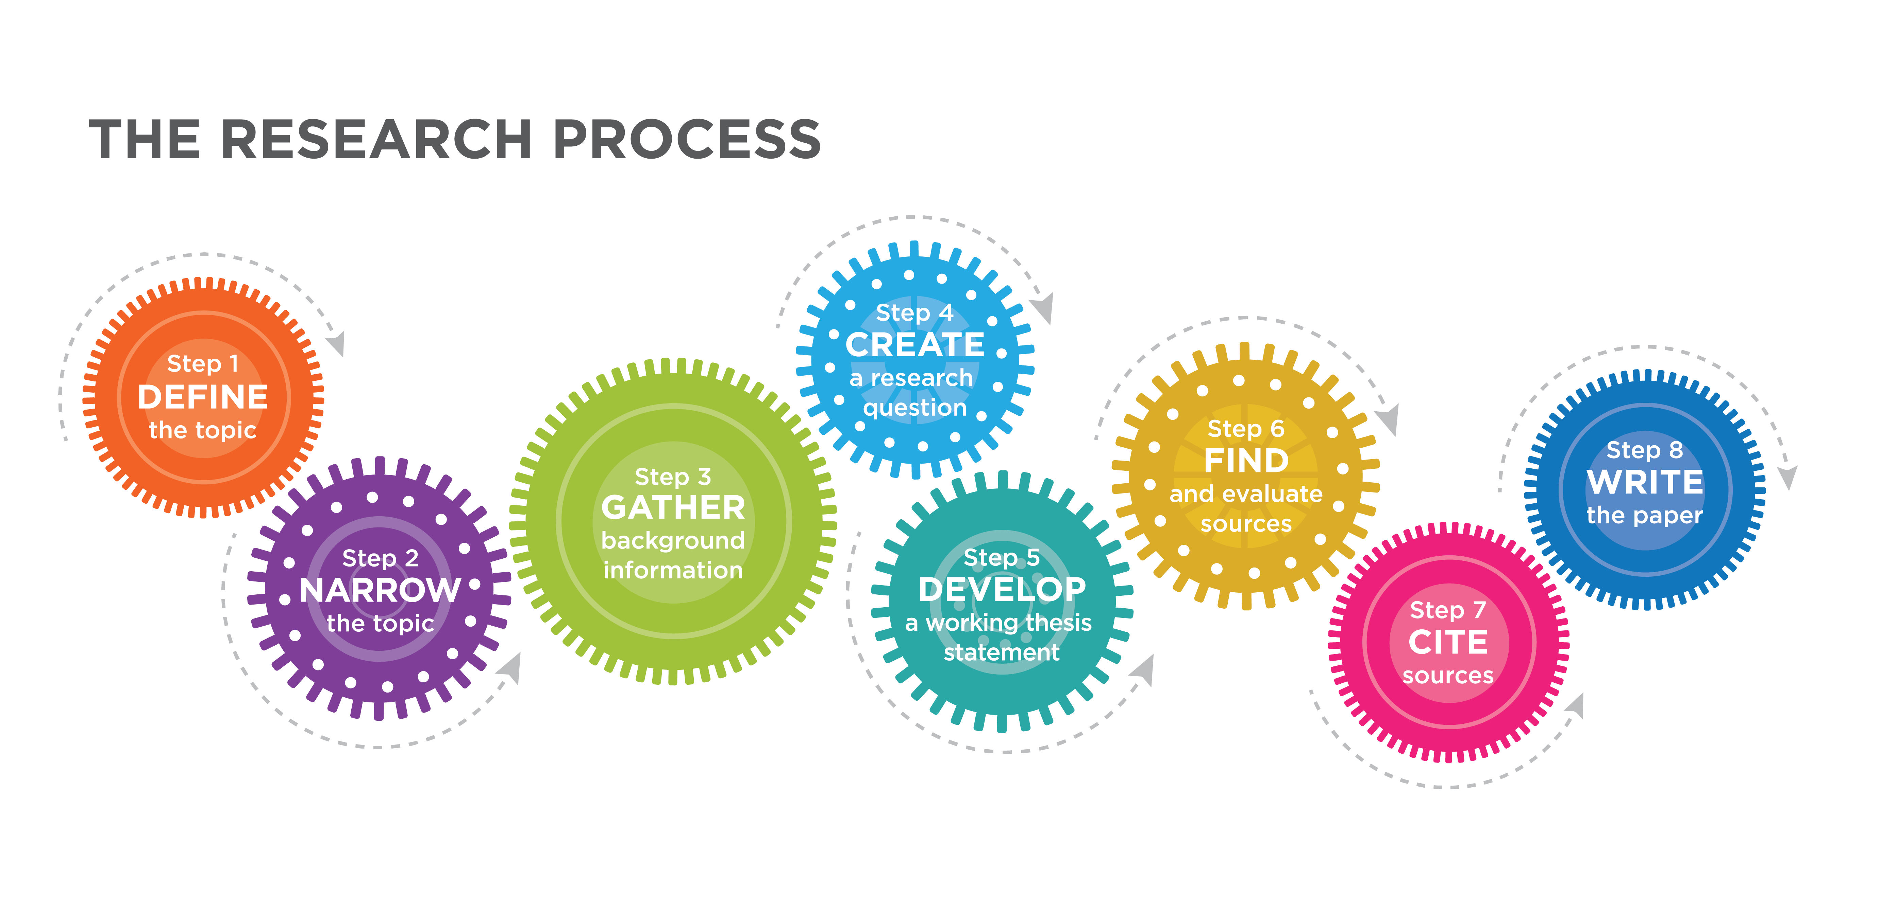

The Research Process is an interactive, non-linear process that requires time and a lot of reading.
This Photo by Unknown author is licensed under CC BY-SA-NC.

Slide 13

Participation Entry Task 4
Don't forget that in Multiple Choice, "all of the following except" means that you are looking for the False answer.

Slide 14
Understanding the Assignment Instructions
This Photo by Unknown author is licensed under CC BY-SA-NC.

Slide 15
First step: Before looking for a topic
Read the teacher instructions and understand the research assignment type and format.
Ask yourself: What is the goal of the assignment?
How do themes and content from the course figure in your final product?
Is there anything you are personally interested in?

Slide 16
Sample assignment instructions in syllabus:
Paper #3: Business Law Thesis Paper (20%) You will write an independently researched thesis paper (outline + 6-8 pages text) discussing a current business law issue of your choice. The issue can come from the textbook, current news, or other class material. I will provide guidance on issues that would be suitable for research for this paper. You will be required to develop a thesis on your selected dilemma and support your argument by describing and discussing the law and policy in question, analyzing the issue and alternative solutions, and supporting your view with citations to at least four relevant outside sources. These sources should generally be peer-reviewed journal articles on law, policy and justice, actual laws and regulations, and court cases. Google and Wikipedia information will not be sufficient sources for this paper. A thesis, outline, and/or draft(s) for this paper will be due prior to final submission.

Slide 17
Paper Requirements in a sample syllabus
Papers must be formatted as follows:
one-inch margins on all sides
double-spaced, without extra lines between paragraphs
Times New Roman, Calibri, or Arial font in 12 point
page numbers on all pages, except the first page if desired o first page heading in upper left corner stating your ID number, prof/class/section, and the date – single spaced, max 3 lines o title, centered above first paragraph, without extra lines after
APA or MLA citations, as you prefer
(1 Syllabus Bus 200 Spr22 v1 2Jan2022 CNSC (tcnj.edu))

Slide 18

2. Finding a Topic
Explore the topic
Brainstorm: Write questions, make lists, make diagrams
Think about ways to narrow and focus your topic
Look for keywords
Make connections to the class content
Talk to your professor

Slide 19
Focusing/Narrowing down your topic
Class in cybersecurity Some keywords
Topics covered in class: business intelligence data mining, information security, risk management, systems security management, penetration testing, network security, and system cybersecurity engineering.
Systems security management: protection of confidentiality, integrity, availability, authenticity, and non-repudiation of user data.
Protection of confidentiality: autonomy, privacy, promise-keeping and utility (or welfare)

Slide 20

Brainstorm research questions for your topic: What is the difference between confidentiality and privacy? What are the laws at state, government or international levels? How to ensure privacy of clients?
Topic:
Confidentiality and Privacy Protection

Slide 21
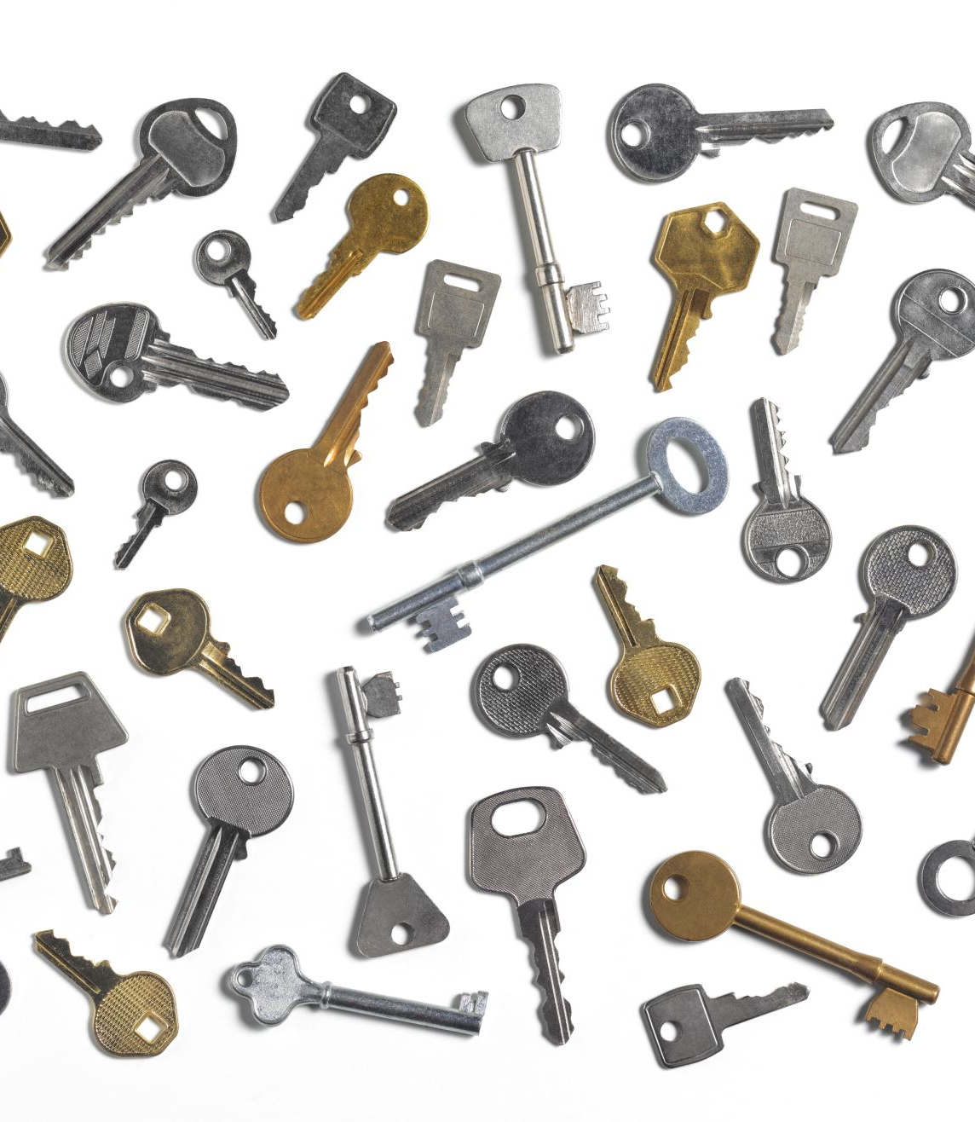
NEXT identify Keywords: The key to a more efficient search of databases. You cannot type a question into the search box in a database.

Slide 22
Keywords: -subject or topic words -synonyms -limiters, such as places or dates -way to narrow down your topic and number of articles

Slide 23
How to search Business Source Complete
Business Source Complete includes scholarly, peer-reviewed journal and trade publication articles on security management topics from publications such as MIS Quarterly, Security Director's Report, and Security: Solutions for Enterprise Security Leaders. Some common search terms include:
cyberterrorism
data protection
data security
emergency management
industries--security measures
information technology security
national security
risk assessment
risk management in business
security management
security measures
vulnerability From Webster Library site
You can add two or three keywords to narrow down your topic, and add a date range and look for information from a specific region or country. All this happens in the search boxes and on the initial search page in the library databases.

Slide 24
3. Start your research
If you haven’t yet, watch the videos – the library is your first stop
Contact your subject librarian and find your subject guide.
Ask yourself questions.
Set aside time every day to search for materials from all resources – catalog, databases, online.
Keep your sources and notes organized or documented in a list on your Onedrive or in a notebook. This is your working bibliography.

Slide 25
How many sources for a research or case study paper?
A rule of thumb: A research paper or essay should have a minimum number of sources as the number of its pages. So, a 3-page paper should have at least 3 sources, and a 10-page paper around 10 sources.
When you find a good source, take notes and keep a record, with a bibliographic entry, APA or MLA, and page number if appropriate.
That way you have it ready for any present or future paper.

Slide 26

Research Sources
This Photo by Unknown author is licensed under CC BY-SA-NC.

Slide 27
Academic Sources vs General Sources
Academic: Used in References
General: Generally not cited
Books
Journals (peer reviewed or not)
Newspapers
Websites of organizations, institutions, etc.
Source usually has authors
Uses keywords in searches
Wikipedia
Google searches
Blogs
Websites without authors or institutions checking them
Popular magazines
Usually has "common knowledge"
You can type in questions

Slide 28
Homework Assignment
Short questions based on a reading and video 2.
Online Library usage: Go the Webster Library site and find the name of your program librarian. Write the name of the program you are studying and the name of the librarian for that program. (1 pt)
Then pick one database and find an academic article that has something to do with your area of study. Write an APA References page entry for that article. (2 pts)

Slide 29
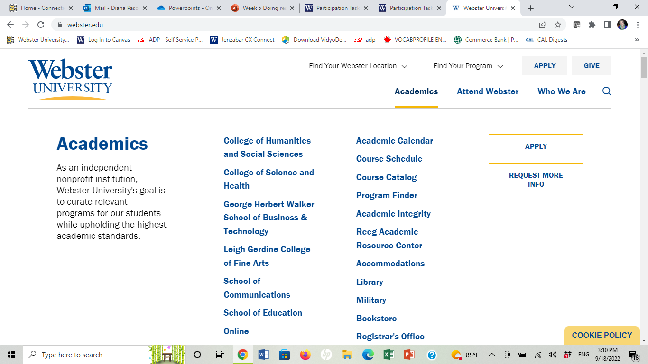

Exploring the Library Website and Databases

Slide 30
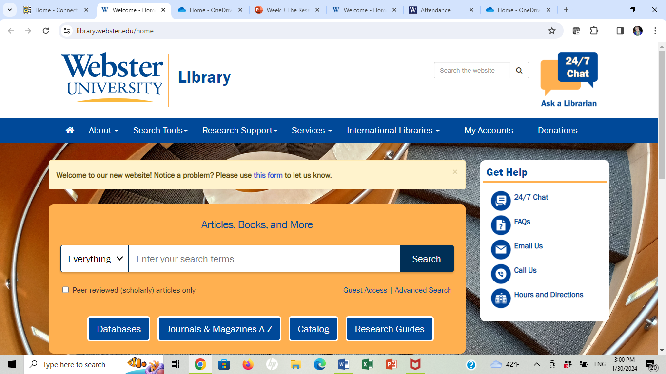
Go to Research Guides

Slide 31
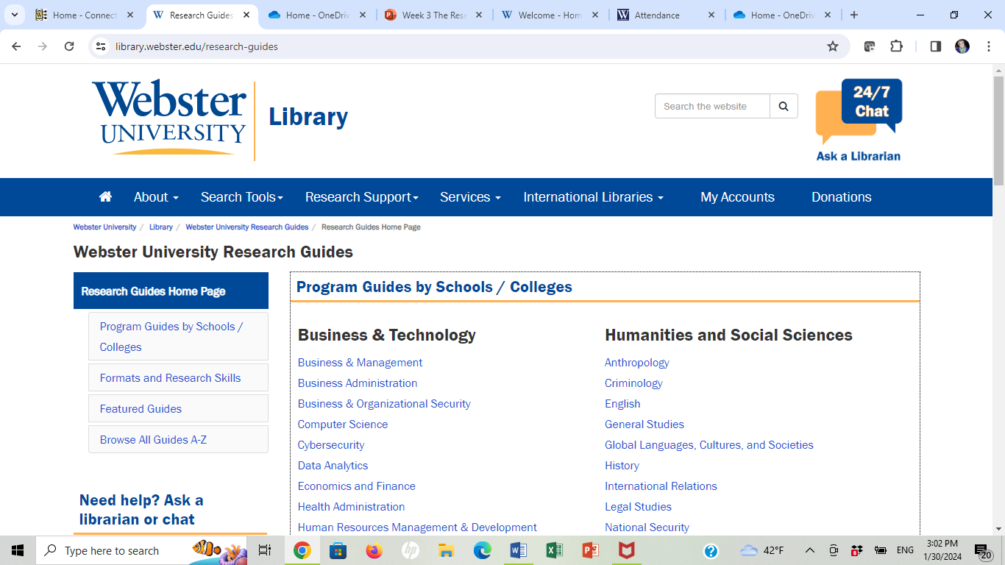
Find your program

Slide 32
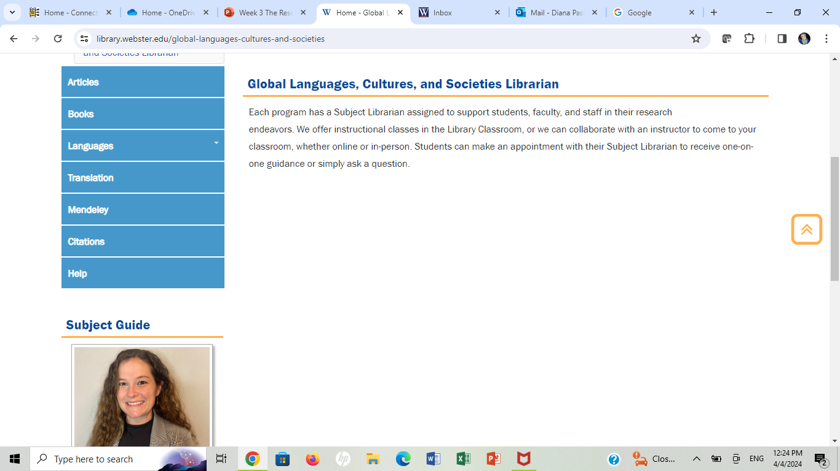
Program or specialist librarian

Slide 33
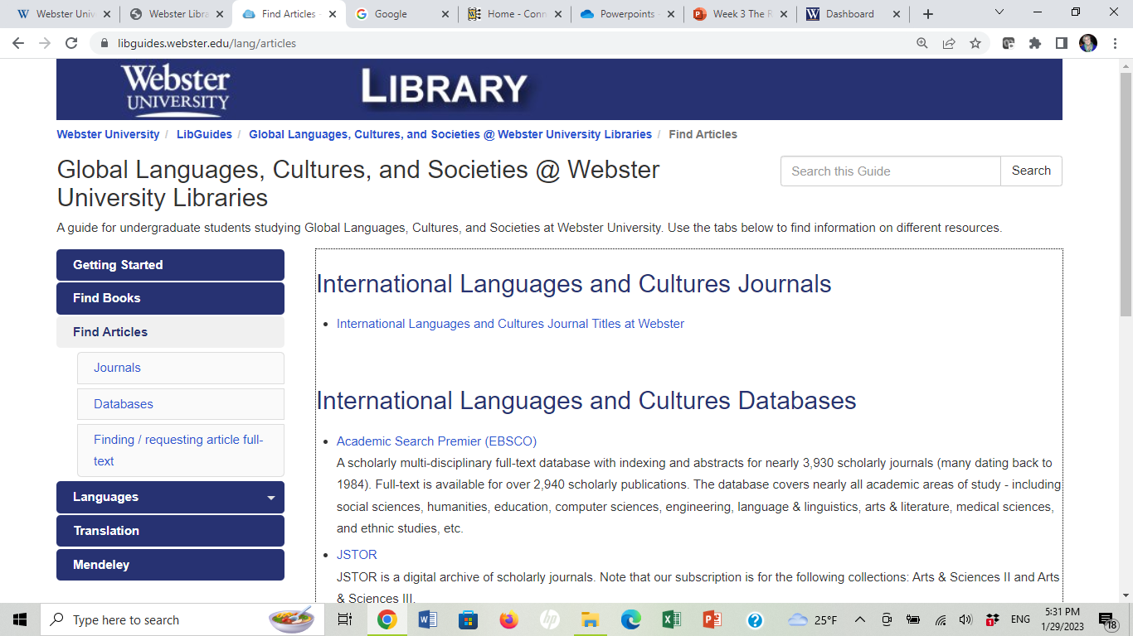
Choose a database and look for an academic article in a journal

Slide 34
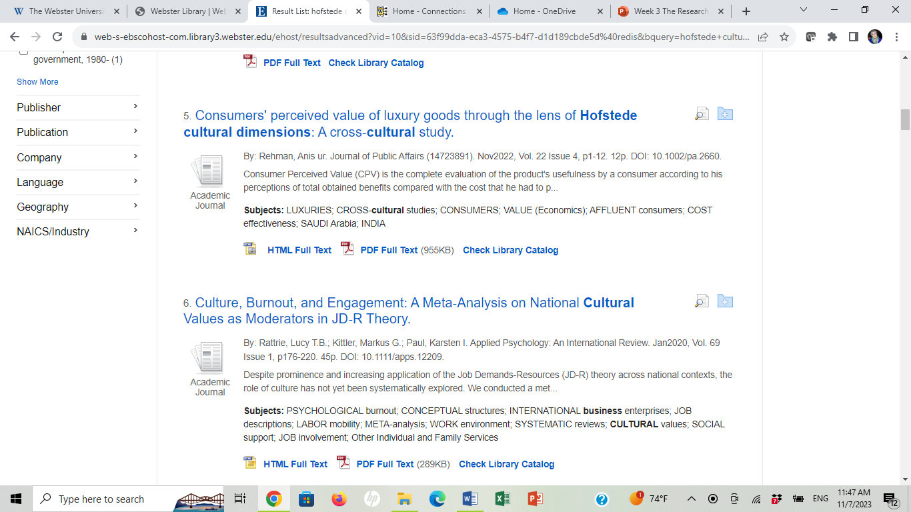

Slide 35
Narrowing down
Culture and Business
Type Business and see choose Business Practices = 14,000 + entries
Add Culture = 734 entries and topics all over the place
I saw the option of adding differences = cultural differences = 12 entries.
The first one in the Result List:
Cultural theory in use: the intersection of structure, process and communication in business practice. By: Schuster, Camille P.; Copeland, Michael J. Journal of Public Affairs (14723891). Nov2008, Vol. 8 Issue 4, p261-280. 20p. 1 Diagram, 1 Chart, 1 Graph. DOI: 10.1002/pa.290.
Examining and understanding the culture of 200+ countries to determine how business is conducted in those countries is a daunting and overwhelming prospect. By combining theories of culture, it i...
Subjects: CORPORATE culture; BUSINESS communication; COMMUNICATION & culture; ORGANIZATIONAL behavior; BUSINESS models; SOCIOLOGY of corporationsCultural theory in use: the intersection of structure, process and communication in business practice. Full Text Available
PDF Full Text(247KB)

Slide 36
Example of the homework assignment:
3. Diana Pascoe Program: Art History, Global Languages, Cultures and Societies
Program Librarian: Julie Laramie
Example of a relevant article in Academic Search Premier, using APA:
Schuster, C. P., & Copeland, M.J. (2008). Cultural theory in use: The
intersection of structure, process and communication. Journal
of Public Affairs 8 (4), 261 – 280. doi:10.1002/pa.290

Slide 37
Today's Homework Assignment: Short Answers
Remember to answer questions specifically. Be concise and direct. Careful with the grammar in the 1st sentence.
Watch the Video 2 Starting research: Look for the specific topic mentioned in the prompt. Use the source mention such as
According to the video Starting research, the most common databases are...
In the video Starting research … there are several ways to find a ….
Some advice the librarian in the video Starting research gives is to brainstorm, read and narrow down.
DO NOT USE "I" phrases. This is not academic language.

Slide 38
Relevant article = something you are studying
If you are studying ITM, an article about schools in Honduras is not relevant, unless it also says something about the use of computers in schools.
If you are studying Business Administration, an article about growing new strains of corn is not relevant.
I may ask you to tell me why your article is relevant.
It must be an article in a journal, not a book, newspaper or conference.

Slide 39

Participation Exit Task 4 The Research Process

